Slide 1
Chapter 8 Computing Innovations

Slide 2
Computing Innovations
Communication Innovation
Collaboration Innovation
Crowdsourcing Innovation
Monitoring Innovation

Slide 3
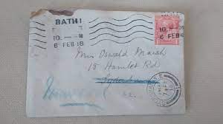


Communication Innovation
In the 1950s, people only had a few options for communicating with each other over long distances: a telephone call, a telegram, or a mailed letter
But then computers, the Internet, and mobile phones happened. Nowadays, we can send an email, write a short text message, post on social media, or use any one of many popular messaging apps

Slide 4
Email
Privacy Concern: Emails can be shared to other parties without the sender’s consent by forwarding, CC’ing, BCC’ing
Notes:
Show example

Slide 5
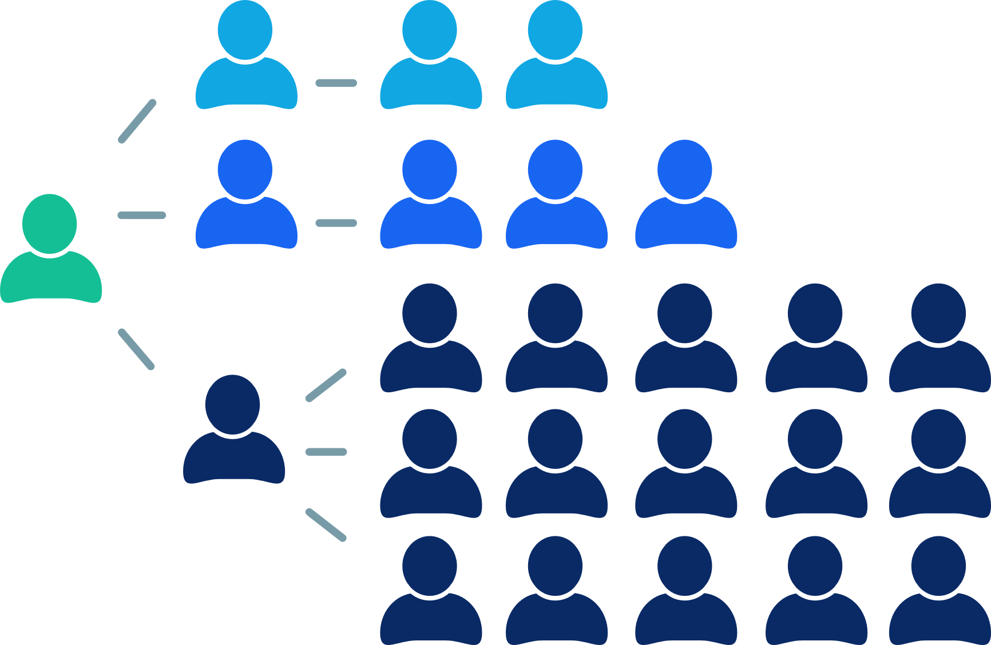
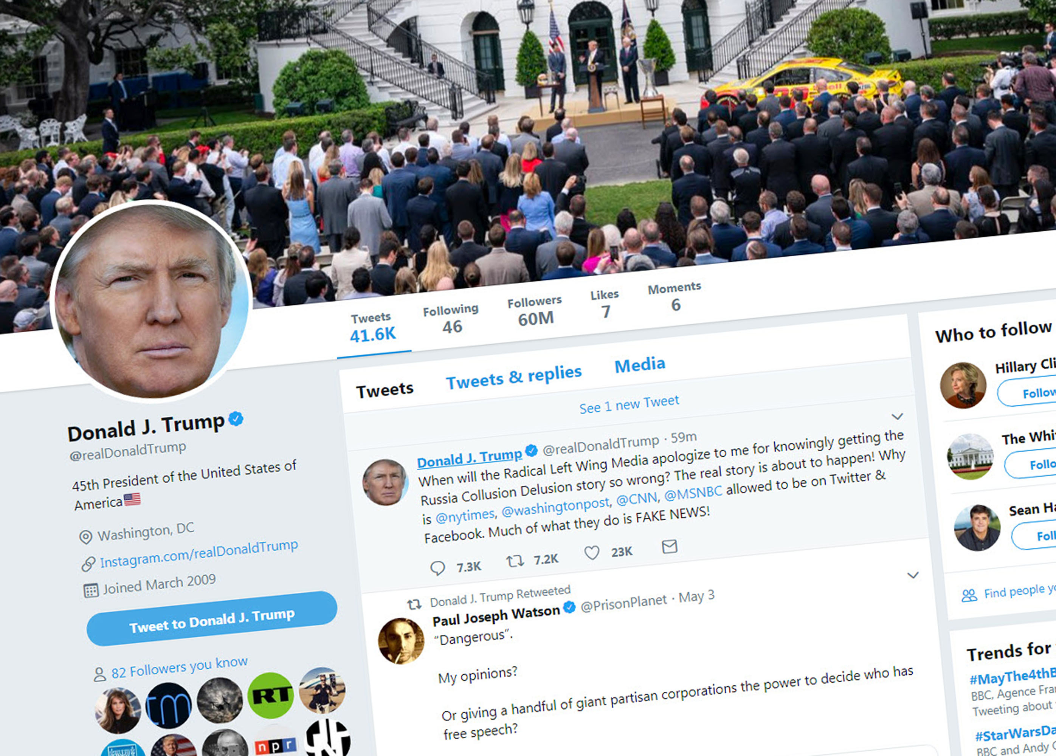
Social Media
Privacy Concerns:
Information placed online can be very hard to delete
Information placed online can be misused
Information posted on social media services could be used along with other information to identify you

Slide 6
Collaboration Innovation
Group Chat
Video Conferencing
Collaborative software

Slide 7
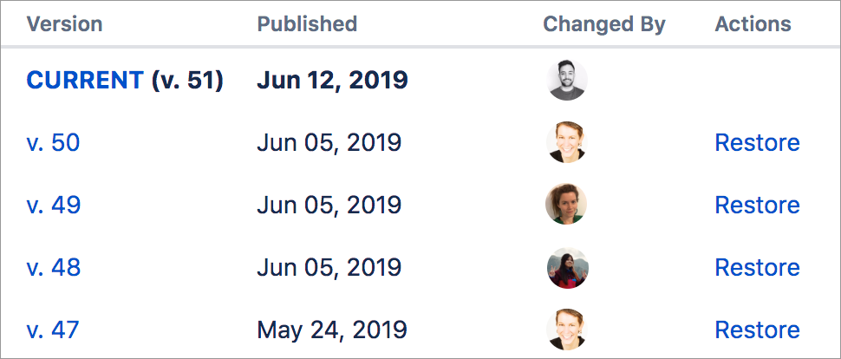
Collaborative software
When multiple people are working on the same digital artifact, they can work more quickly and build on each other's ideas—but they might accidentally overwrite each other's contributions. That's why most collaborative software also includes revision history

Slide 8
Crowdsourcing Innovations
Crowdsourcing is the practice of obtaining input or information from a large number of people via the internet
Examples of crowdsourcing include:
Crowdfunding
Citizenscience

Slide 9
Crowdfunding
Crowdfunding is a way to raise money for an individual or organization by collecting donations through family, friends, friends of friends, strangers, businesses, and more
https://www.kickstarter.com/?country=US

Slide 10
Citizenscience
Citizenscience refers to the participation of the general public in scientific research
Ex: Creating data labels for computer vision algorithms
Ex2: Volunteer computing

Slide 11
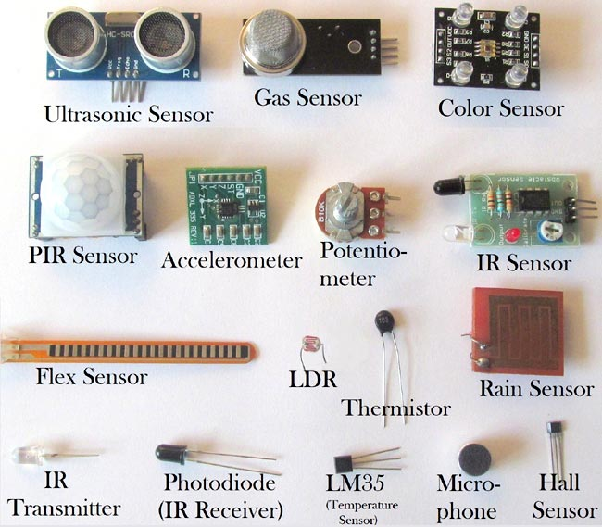
Monitoring Innovation
Sensors: A sensor is a device that detects and responds to some type of input from the physical environment. The input can be light, heat, motion, moisture, pressure or any number of other environmental phenomena

Slide 12
End of Chapter 8

Slide 13
Copyright, legal and ethical concerns
The majority of creative works are copyrighted, which means they are the intellectual property of the creator. Copyright gives the creator legal rights to determine whether their work can be copied and under what conditions

Slide 14
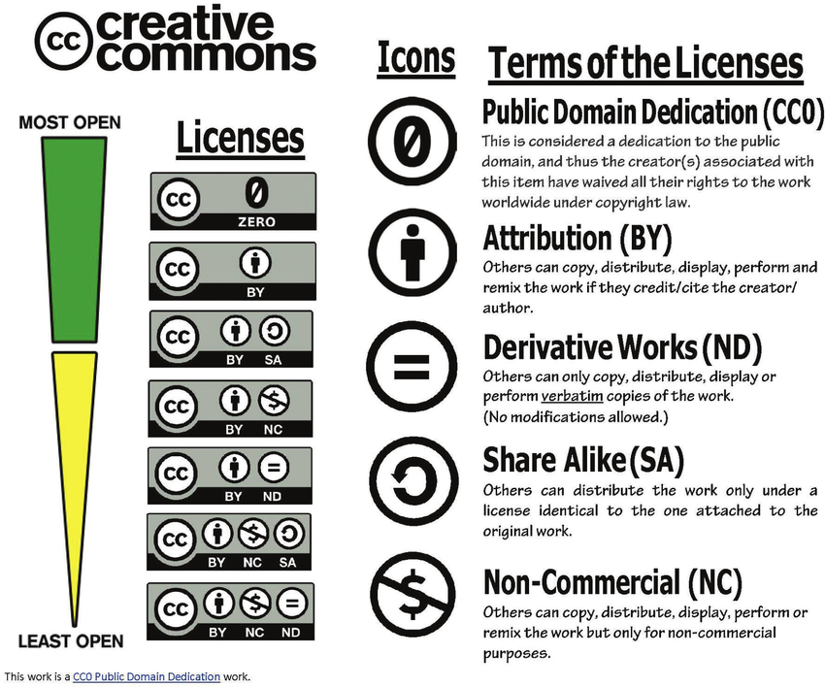
Creative commons
Creative commons: apubliccopyrightlicense that enables the free distribution of an otherwise copyrighted work.

Slide 15

Open Source
When a programmer wants to make their code reusable, they publish it online under an open source license. That license enables other programmers to bring the code into their own projects, and it may be redistributed and modified
Notes:
https://github.com/labstreaminglayer/pylsl

Slide 16
Open access
Online research output (journals) that is free to distribute and download

